Slide 1


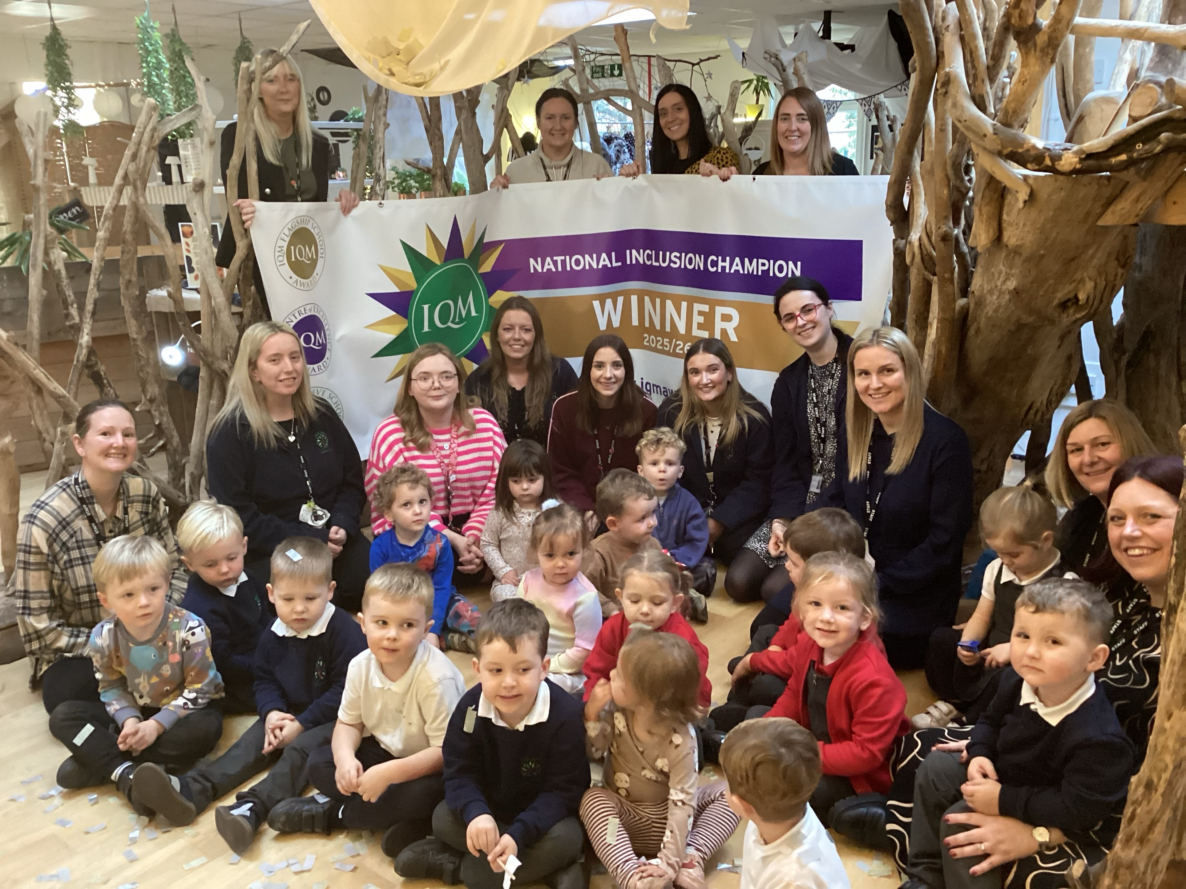




Newsletter: Autumn term 2
We had a wonderful first half term in nursery and children are now becoming familiar with routines and rules within nursery. We learnt all about autumn and the changes in season and it was wonderful to see so many of you on our autumn walk and at our Halloween / harvest singalong. A big thank you for your harvest donations for the community and your Children in Need donations too, the children looked fantastic on our Pudsey / Superhero day.
As part of our Anti-Bullying week discussions, we talked about respecting the space and boundaries of others and always ensuring we are kind. We talked about how our bodies have a personal space bubble and other people should ask permission to come into it. Nobody should use unkind hands or feet to enter someone’s space bubble and touch or hurt them. In nursery we use social stories with puppets as a strategy to help children understand and carry out appropriate behaviour interactions. We have also talked about how we are all unique and that our differences should be accepted and celebrated by others. We have talked about how our brains all work differently and how a friend might experience something different to the way we do.
Please talk about these themes with your child at home, perhaps thinking of ways they can be kind to others in nursery or how they might react to someone who is different to them. Inclusivity is very important to us at nursery and we are proud to announce that we have been awarded the prestigious status of National Inclusion Champions, one of only 8 schools in the UK to achieve this accolade. We would like to thank our families for your support, and we look forward to the journey ahead as National Inclusion Champions.​
School Holidays and INSET
As a maintained school we are required to take in-service training throughout the school year. As a result of this, both the nursery and childcare will close early at 4pm on the following days to allow training to take place:
Wednesday 26th November 2025
Wednesday 10th December 2025 (Family Christmas night starting at 4.30)
Wednesday 4th February 2026
Wednesday 25th March 2026
Wednesday 13th May 2026
Wednesday 24th June 2026
Thursday 2nd July 2026 (Summer celebration starting at 4.30)
INSET days will also take place on the following days
meaning nursery will be closed for 5 days.
Mon 20th July - Fri 24th July 2026
Christmas Holiday
Nursery closes at the end of the day on Friday 19th December and reopens on Monday 5th January 2026
www.millhillnursery.org.uk
Head Teacher: Sarah Dixon-Jones
Inspiring Foundations
Inspiring Foundations
www.millhillnursery.org.uk
Head Teacher: Sarah Dixon-Jones

Slide 2
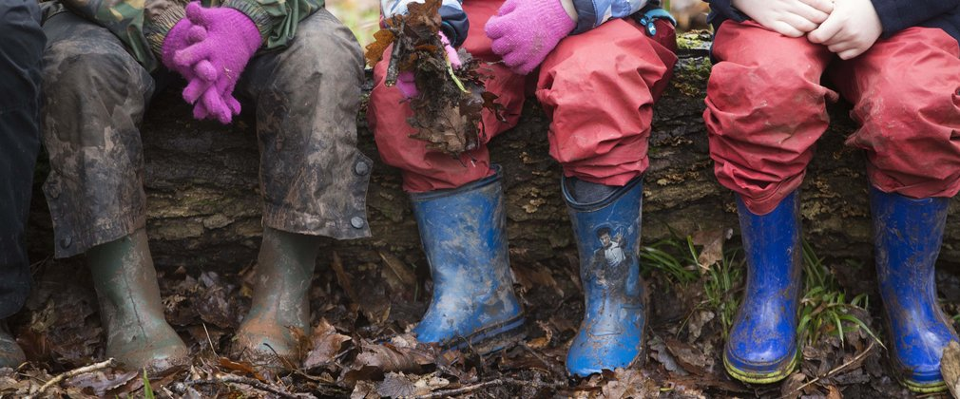

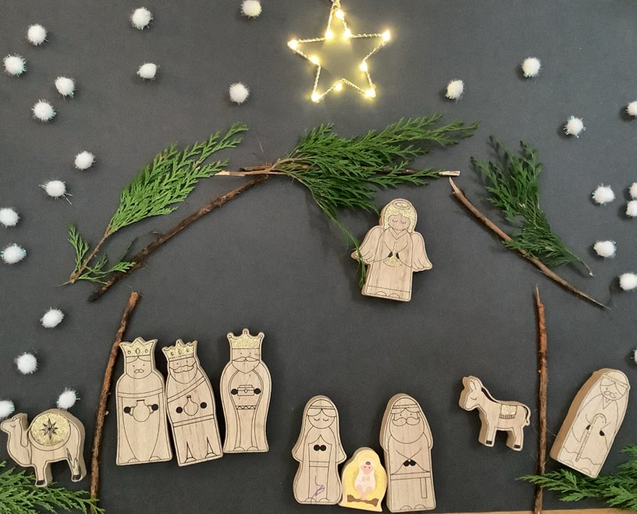

How you can help at home:
Practise little and often – let your child try putting on their shoes and coat themselves, even if it takes a bit longer.
Talk through the steps – naming items and explaining what goes on first can make it easier.
Celebrate effort, not perfection – praise them for trying, even if they need help finishing.
Make it fun – turn it into a game or race to keep them motivated.
These small steps really support their independence in nursery and help them feel proud of what they can do! Thank you for working with us to help your child grow in confidence and independence. Please make sure shoes are also labelled with your child’s name or initials.
Helping Your Child Build Independence
As the colder, wetter weather sets in, we’re encouraging our nursery children to become more independent with their outdoor clothing. Putting on and taking off shoes, waterproof trousers, and coats can be tricky at first, but practising these skills helps build confidence and self-care.
.
Christmas
Dates for your diary…
With more information to follow.
Family Night – Light Walk - Wed 10th December
We invite our families to join us in getting in the festive spirit at our Christmas family night. Nursery will close at 4pm on this day. We will then meet at the front of nursery at 4.30pm to walk to St Matthew’s church for a Christmas celebration, shining our lights and twinkling all the way. This will end at approximately 6.00pm.
Christmas Jumper day – Fri12th December
Children can come to nursery wearing their own Christmas themed jumper / t-shirt / dress, if they wish.
Christmas Party Day – Mon 15th December
We will be having our own Christmas party on Monday 15th December in nursery. Children are invited to wear their Christmas party outfits for the day if they wish. We will have lots of festive activities throughout the day including party games, a party snack, singing and dancing. If your child does not attend on this day, they are welcome to come into nursery for 9.30-10.45. Please let your child’s key worker know.
Polar Express Day – Tues 16th December
On Tues 16th December, we will be having our very own Polar Express pyjama day. Children can come to nursery wearing their pyjamas. Within nursery, we will have Polar express themed activities and treats.
Wellbeing Wednesday – Wed 17th December
Wednesday 17th December is this half term's Wellbeing Wednesday. This time, our theme is 'Community Kindness’ We will hopefully visit Haddington Vale to have a festive singalong for the elderly residents. We invite you to make a Christmas card that we can take along for the residents and bring it in on this day

