Slide 1


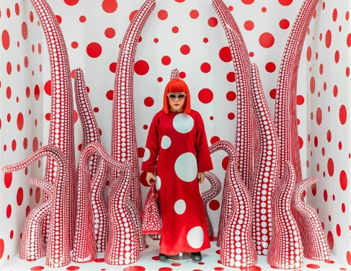


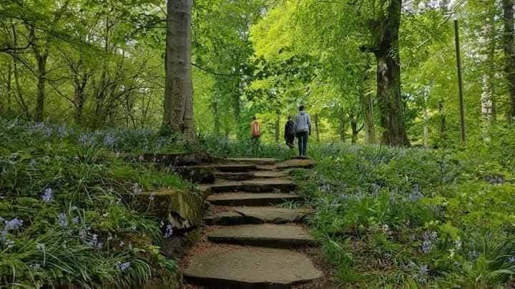






Mill Hill Nursery School
Newsletter – Summer 2025
We can't believe we are now in the final half term of the school year; we would like to thank you for your continued support over the last year and share some of the exciting things we have planned, as many of our children start to make their transition to school.
As part of our work on Yayoi Kusama’s iconic dots and circles, we are enhancing our nursery environment with dotty patterns and round items. If you have any spotty clothes (children’s or adult’s) or small round clocks you no longer need, we would be very grateful for your donations. Thank you.
World Environment Day – Thursday 12th June
World environment day is celebrated in June and to mark the occasion we will be having a special outdoor session in our very own forest. Children will learn about how we can care for the environment, carry out a litter pick and we will experience the wonder of nature outdoors. Children will also experience the natural elements and share some campfire snacks. Please make sure your child is dressed appropriately for the weather on this day.
Father's day celebration – Friday 13th June
To celebrate the wonderful men in our lives, we invite a male family member to join your child for a walk to Doxford park as we look out for signs of summer. Bring your picnic snacks and a blanket to share some special time together. Meet us outside of nursery at 1.00pm on Friday 13th June.
Sunderland Museum and Winter Gardens Exhibition
We would like to invite you to the opening celebration of our very own art exhibition, ‘The Power of the dot’. The provisional date we have been given for this event is Wednesday 18th June. Families are welcome to join us at the museum between 4.30-6.30. More details will follow soon with confirmed date, time slots and organisation.
SCHOOL HOLIDAYS
Nursery closes at the end of the day on Wednesday 23rd July. From Thursday 23rd July, nursery will be open only to those who attend all year around.
Our returning children will come back to nursery on Thursday 4th September.
www.millhillnursery.org.uk
Head Teacher: Sarah Dixon-Jones

Slide 2



Mill Hill Nursery School
Newsletter - Summer 2025
School transitions
Most of our children are ready to embark on the next chapter of their journeys: making the move to school. Children will be meeting their teachers and will have the opportunity to visit their new setting. Children will have the opportunity to visit Mill Hill Reception with nursery staff on the morning of Wednesday 2nd July and the afternoon of Monday 7th July. If your child does not attend on these days or times, they are invited in for the morning session on the 2nd 9.00-11.45am and the afternoon session on the 7th 1.00-2.45pm.
Please send a message via Seesaw if you would like your child to attend for the extra session. Mill Hill Primary School will also have a reception open evening (Parents only) on Thursday 19th June. Please contact school for more details.
On Wednesday 9th July, Mill Hill Primary school staff will come over to nursery to read a story to the children, your child can also attend on this day if they are not in, please confirm attendance and times via seesaw. If your child is moving to another school, we will be in touch with them regarding transition arrangements, if you would like any support with any transition information, please let us know.
Wellbeing Wednesday – Aspirations Day
Wednesday 9th July is this term's Wellbeing Wednesday. This time, our theme is 'Aspirations day'. We invite all children to come to nursery dressed in a costume, outfit or accessories that represents their aspirations for the future and show what they might like to be when they grow up. For example, this could be a doctor's jacket, hairdresser's belt, footballer's kit etc. Mill Hill Primary School Reception staff will also be visiting this day so you can share your aspirations with your new teachers.
Our end of year parent meetings will take place in July. If you would like to chat about your child’s progress, a booking link will follow soon.
Jade’s group Monday 7th July
Jenna’s group Wednesday 9th July
Jamie & Natalie’s Friday 11th July
Sarah’s group Monday 14th July
Michelle’s group Wednesday 16th July
End of year celebration
Our end of year celebration will take place on Friday 18th July. From 1.30pm. Join us in nursery for a garden party and a wonderful end of year celebration. More details will follow soon.
www.millhillnursery.org.uk
Head Teacher: Sarah Dixon-Jones

