Slide 1


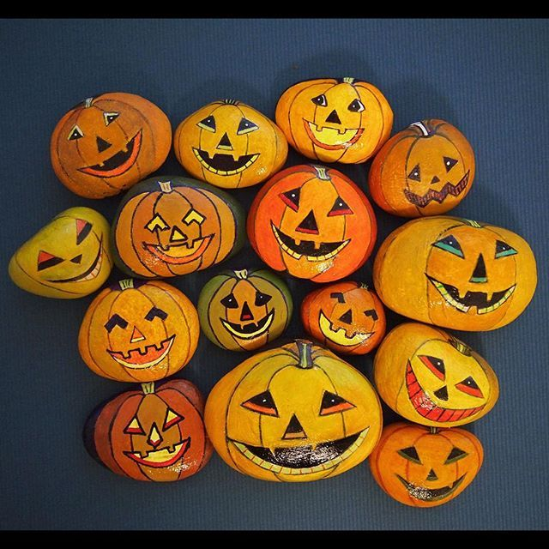

Newsletter – Autumn 2025
We would like to welcome everyone to the start of our new school year and thank you for supporting us during our induction period. It has been a very busy couple of weeks in Mill Hill Nursery, with many new children starting in our baby room The Nest, The Den and Main Nursery. It has been wonderful to see how quickly most children have settled and how they are enjoying the wide range of activities that are on offer. Myself and the staff are enjoying getting to know you all and we are excited about what lies in store for the year ahead. During these early days, please can we ask that family members are patient and respectful when dropping children off and picking children up. Please stand back to wait your turn with your child to allow the children ahead of you to have a smooth transition. Please do not allow your child to run in ahead of you. We kindly ask that family members do not come into the main porch where children hang up their possessions, this helps the children with their separation and fosters a positive start to their session.
We have a busy term ahead and we wanted to let you know of some important information and also give you some dates for your diary. We will hopefully have everyone connected on Seesaw very soon, if you are still unable to connect, please see a staff member.
Autumn Walks
We would like to invite families to join us on a seasonal Autumn walk to Doxford park where we can search for signs of Autumn and explore our local area together. All children will need an adult with them to take part.. The walk will last around 1.5 hours and we will all leave from the front of nursery and walk back together Come and join us on:
Tuesday 14th October 9.15am for Sarah, Jenna and Michelle’s groups.
And Wed 15th October 9.15am for Jamie and Leanne’s groups.
Autumn Walk Surprises…
In preparation for our Autumn walks, we are asking for your help. We would love it if you could paint a Pumpkin themed stone and then hide it around Doxford park for us to find on our Autumn walks.
We hope that you can help to make our Autumn walks a success!
A Few Reminders:
Please remember to put your child’s name in ALL OF THEIR clothes, including shoes and please include spare clothes, pants and socks in your child's bag. Please can all parents of children who have moved ‘rooms’ make sure that their child’s information is up to date in particular your address, telephone numbers, and medical information. Please remember that if you child has sickness or diarrhoea that they must stay away from nursery for 48hrs to prevent spreading illness. Also, if any new medication has been administered children must not come into nursery for 48 hours, if a child has taken pain relief such as Calpol, they will not be allowed to come to nursery for 24 hours.
Macmillan Coffee Morning. We would like to host a cake sale to raise funds for Macmillan, cake donations can be brought into nursery for Thursday 25th September ready for our sale on Friday 26th. Each group will be having some special activities all planned around Macmillan and you can purchase a cake for a small donation. Thank you.

Slide 2

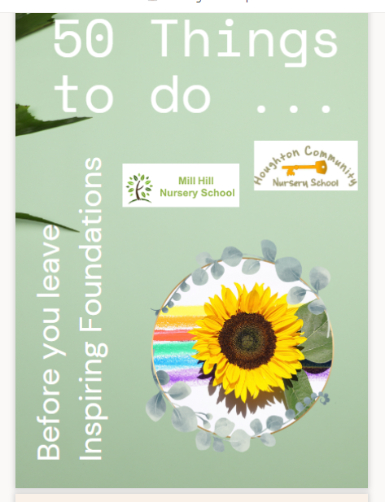





​
Mental Health and Wellbeing: Wellbeing is very important to us in nursery. Did you know that Sarah and Michelle are both mental health first aiders and are on hand to help if ever you need it
Well-being - Wednesday 8th October: The joy of being me! Children can come to Nursery in a special self-chosen outfit. The outfit might represent any hobbies they enjoy or colours / styles they love. We will talk in nursery about how we are all unique and share our likes and dislikes.
World Mental Health Day​ - Friday 10th October​: Children are invited to wear a green item of clothing or bow / headband etc to raise awareness of the importance of talking about mental health and will take part in special activities throughout the day.
50 things to do:
All families will soon receive 50 things to do over your child’s journey with us. When you achieve these specific tasks, you might like to tick them off the list in your book and over your time with us hopefully you will have gained some treasured memories of your time together. Next half term we will start our half termly play sessions where you can come in and play with us in to gain an insight into our learning environment and provision on offer.
Harvest / Halloween sing-along​ - Wednesday 22nd October ​
More details to follow but please come save the date for our singalong on Wed 22nd October. Children can dress up for Halloween on this day if they wish.
Jamie and Leanne groups – 10.30am
Sarah, Jenna and Michelle’s groups – 2.00pm
We’re kindly asking for donations of fresh, tinned and packaged food to form as part of our harvest festival table. The donations will all be donated within our local community. These can be brought into nursery week beginning Mon 20.10.25
SCHOOL HOLIDAYS
As a maintained school we are required to take in-service training throughout the school year. As a result of this, both the nursery and childcare will close early at 4pm on the following days to allow training to take place:
Monday 22nd September 2025
Wednesday 8th October 2025
Wednesday 26th November 2025
Wednesday 10th December 2025 (Family Christmas night starting at 4.30)
Wednesday 4th February 2026
Wednesday 25th March 2026
Wednesday 13th May 2026
Wednesday 24th June 2026
Thursday 2nd July 2026 (Summer celebration starting at 4.30)
Half Term Holiday
Nursery closes at the end of Friday 24th October and reopens on Monday 3rd November
Christmas Holiday
Nursery closes at the end of the day on Friday 19th December and reopens on Monday 5th January 2026
INSET days will also take place on the following days meaning nursery will be closed for 5 days.
Mon 20th July - Fri 24th July 2025
www.millhillnursery.org.uk
Head Teacher: Sarah Dixon-Jones
Inspiring Foundations

