Slide 1


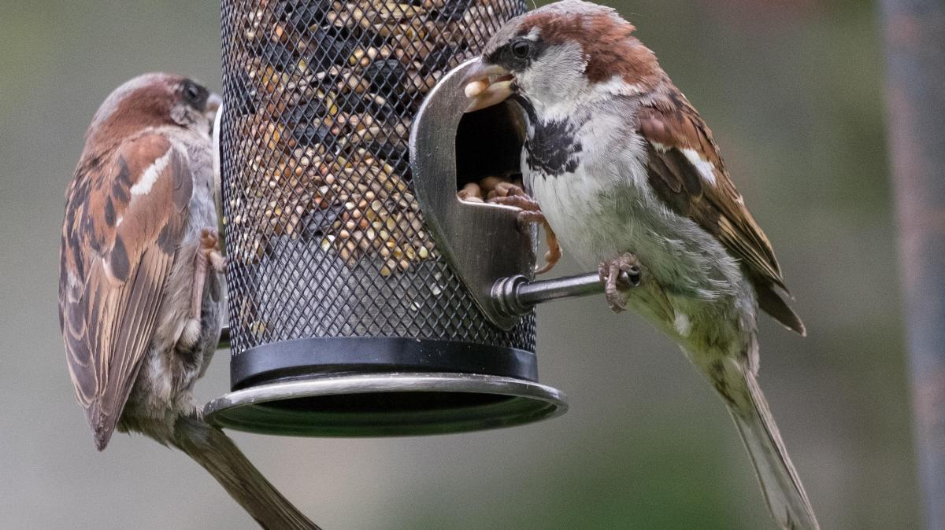



Newsletter – Spring 1 term
We are excited to welcome all of our new starters and parents to Mill Hill and would like to say a warm welcome back to all of our returning children. We have a busy half-term planned and would like to share some of the exciting things happening within nursery and important dates for your diaries. Just a reminder, please could we ask that you support us during our welcome times and home times and try to arrive and pick up at designated times. If your child attends breakfast club at 8am, they should arrive before 8.20 to get their breakfast. For children arriving at 8.45, our door will remain open until 9am to ease the flow of children coming into nursery and support those children who are finding the separation difficult on a morning. This means there will be a 15min window of time for pickups / drop offs. Our main automatic doors will remain closed on a press release system. Please be vigilant about doors closing as your child goes through. If your child is coming into nursery upset, you might choose to come closer to 9am when the door is not as busy. This will also apply to our 2.45pm home time, a staff member will stay on the door until 3pm to let family members in.
​Staff Training- Wednesday 29th January​
Nursery will close to all children at 4pm on Wednesday 29th January to allow for important staff training to take place. Please ensure your child is collected on or before this time. Thank you.​
RSPB Big Garden Bird Watch​
The RSPB are holding their annual 'Big Garden Bird watch' which will take place 24th - 26th January Within nursery, children will be learning about our garden wildlife and taking part in our own 'garden bird watch'. We would love if you could join in with this at home and continue it over the weekend. We will send some ideas for home and we would love for you to share any photos with us, via seesaw. If you wish to find out more details about this event please visit the RSPB website:
https://www.rspb.org.uk/whats-happening/big-garden-birdwatch
National Story Telling week ​- 1st –9th February​
Saturday 1st -Sunday 9th February is 'National Story telling week'. Within nursery, we will be focusing on stories and over the week, we will create our own stories within our family groups and areas. Monday 3rd February family members are invited to our story family workshop. The focus will be on the core book for that week, 'The Legend of Nian' as we also celebrate Chinese New Year
10.15 - 11.00 Michelle's and Sarah's groups
1.30 - 2.15 Jamie / Natalie's and Jade and Jenna's groups
​
Chinese New Year – Chinese new year begins on 29th January and lasts until 12th February. To celebrate, we will be learning all about the Chinese culture, traditions and celebrations. On Monday 3rd February, we ask children to wear something red as part of the celebration on the day of our story session (a colour representing luck in Chinese culture).
SCHOOL HOLIDAYS
We will also host a book swap shop this week... More details to follow soon.
Early reading and literacy talk (Parents only)​ - Wednesday 5th Feb 4-5pm​
Many of you have asked about how reading and literacy is taught within early years and I am sure some of you may be interested in what children need to be able to do to develop different literacy and phonics skills. Linking in with National story telling week, Sarah will be leading a parent talk all about what comes before phonics and how children develop these important skills in preparation for school. This talk will take place on Wednesday 5th Feb 4pm-5pm. It would be lovely to see as many of you come along as possible. (Please note this isn't a stay and play workshop but a discussion about early reading and phonics for parent only).​ If you wish to attend, you can drop your key worker a message..

Slide 2







Newsletter – Autumn 2023
Children's mental health week takes place between 3rd and 9th February and this year the theme is 'Know Yourself, Grow Yourself'. To celebrate this, within nursery we will be thinking all about what mental health is and taking part in activities which support good mental health and wellbeing.
The theme will put a spotlight on how we can build resilience, grow and develop by understanding who we are, our emotions and feelings.
To link in with children's mental health week and safer internet day (Tues 11th February) we have decided to hold a zoom call for all of our children and families to join where we will sing some songs and introduce being safe online. This will take place on our Wellbeing Wednesday 12th February at 4pm. More details on this will follow soon.
NSPCC National Number Day – Friday 7th February ​
To celebrate national number day, we have decided to dress in numbers. On Friday 7th February, children are welcome to come to nursery wearing an outfit which has numbers on it. For example, this could be clothes with numbers visible, a football top, a number badge, number blocks dress up or you could make your own number themed outfit to wear. Throughout the day, we will be taking part in lots of lovely maths activities within our areas.​
​
2025
Wellbeing Wednesday 12th February and Winter walk – Friday 21st February
This wellbeing Wednesday's theme is 'Nature appreciation'. We will be visiting our nursery forest to experience the elements and share lots of wonderful activities linked to wellbeing outdoors. With this in mind, we would also like to invite our families on our winter walk on Friday 21st February. We ask that all children have a family member attend the walk with them. Group times will be as follows:
Michelle, Jenna and Sarah's groups – leave from main nursery entrance 9.15am (if your child is in one of these groups and does not attend a morning session, you are welcome to join us for the walk). The walk should last no longer than 90 mins. You can bring your child at 9.15 if you wish, please let your child's key worker know via Seesaw.
Jamie / Natalie's and Jade's group – leave from main nursery entrance 1.15pm. As above, if your child does not attend at this time, you are welcome to join us for the walk.
The last day of this half-term will be Friday 21st February when we break up for one week.
Nursery will be open during the half term holiday for children who attend all year round between Monday 24th and Friday 28th February.
Spring term 2 will commence when we return on Monday 3rd March 2025.
www.millhillnursery.org.uk
Head Teacher: Sarah Dixon-Jones

