Slide 1




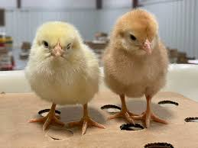




Newsletter – Spring 2 term 2025
We have a busy half-term planned and would like to share with you some of the exciting things happening within nursery and important dates for your diaries. We are currently talking about signs of spring, new life, weather changes and growth.
Staff Training- Wednesday 26th March 2025
Nursery will close to all children at 4pm on Wednesday 26th March to allow for important staff training to take place. Please ensure your child is collected on or before this time. Thank you.​​
​
.
World Down Syndrome Day – Friday 21st March 2025
On Friday 21st March we will be celebrating World Down Syndrome Day. We would like to raise awareness by asking children to wear two different socks to celebrate the diversity and differences between us all and the things that make us special. We can’t wait to see pictures of your sunflowers at home too as we take part in the WDSD sunflower challenge. Just like sunflowers, every child grows and blooms uniquely.
Living Eggs
Main Nursery will be welcoming living eggs Monday 24th March for two weeks. This is a wonderful experience to allow children to see parts of the life cycle first hand. We also keep in touch with our chickens from last year after re-homing them with nursery friends and families. We are looking forward to seeing how much they have grown.
.​
Mother’s day celebration - Friday 28th March
Pastries and Painting
To celebrate Mothers day, we would like to invite you into the studio in nursery to come to our pastries and painting session. Come to our drop in session to share a delicious treat together and play in our art studio. A special family lady can come and join us between 9-10am or between 1.30-2.30. If you can make it, please message your child’s key worker to confirm which session you would like to attend.
www.millhillnursery.org.uk
Head Teacher: Sarah Dixon-Jones

Slide 2

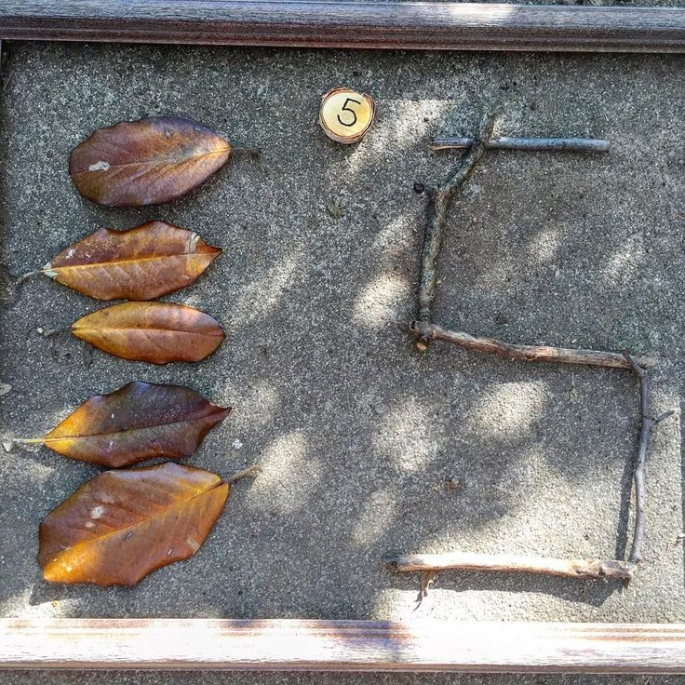

Newsletter – Spring term 2
Mid-Point Parent Key worker meetings
Most family groups have now had their parent meetings, it was great to catch up with you and have a chat your child’s development and learning and celebrating successes. If you didn’t manage to book an appointment and would still like one, please let us know, we will have another parent update meeting in the summer term.
Autism Acceptance day – 2nd April 2025
Wellbeing Wednesday
We would like to celebrate Autism awareness and acceptance day. We will learn about Autism and celebrate our individual likes and dislikes. We would like children to express their individuality by dressing in an outfit of choice or in their favourite colour. We will take part in some colourful sensory based activities, and our focus book will be 'Tomas Loves', a story about a little boy who has Autism and all the things he likes and dislikes.
Maths parent workshop​
Wed 2.4.25 3.30-4.30
Thanks again to the family members who attended our early reading and phonics. As lots of you mentioned how helpful it was, we would like to invite you to attend our next workshop all around maths in the Early years and discuss the importance and skills needed to be a strong mathematician. Come along to nursery on Wed 2nd April at 3.30pm. We have been practising our touch counting and subitising at nursery, maybe you could practise at home too.
​Spring Sing-along – Mon 7th April
We would like to invite our families into nursery to join us for our spring singalong. As part of our singalong, we invite children to make a small Easter bonnet at home which they can wear during the singalong.
Jamie & Natalie / Jenna / Michelle’s groups – 10.30am
Sarah / Jade’s groups - 1.45pm ​
If your child does not come to nursery on this day, they are welcome to attend. Please send a message on Seesaw to confirm. ​
SCHOOL HOLIDAYS
The last day of this half-term will be Thursday 10th April. Nursery is closed on Friday 11th April and will reopen to all children on Monday 28th April 2025.
Nursery will be open to children who attend all year round excluding Good Friday (18th) and Easter Monday (21st)

